Slide 1



EE3203 - Individual Project - Proposal
automatic power factor correction

Slide 2
Problem - Due to increasing use of inductive loads, the load power factor decreases considerably which increases the losses in the system. It makes commercial losses and decreases the efficiency of the system.
Solution – This project proposes to minimize the energy consumption and thus reduce the power loss in industries and establishments by making use of a number of shunt capacitors. This substantially reduces the electricity bill commercially.
Benefits from this - Efficiency of supply system increases
money will be saved commercially
Reactive power decreases
Transmission loss decreases
Overloading is avoided

Slide 3
LITERATURE SURVEY
Others did,
“Automatic Power Factor Detector and Corrector” from electronicwings – this is for a house purpose only
Research paper on “Automatic Power Factor Correction for Single Phase Domestic Loads”
“Automatic Power Factor Correction Using Arduino” from Journal of Emerging Technologies and Innovative Research
“Commercial Power Saver Project” from nevon projects
The main adverse effects of these projects are,
Resonant frequency is below the line frequency
Current and voltage increases

Slide 4
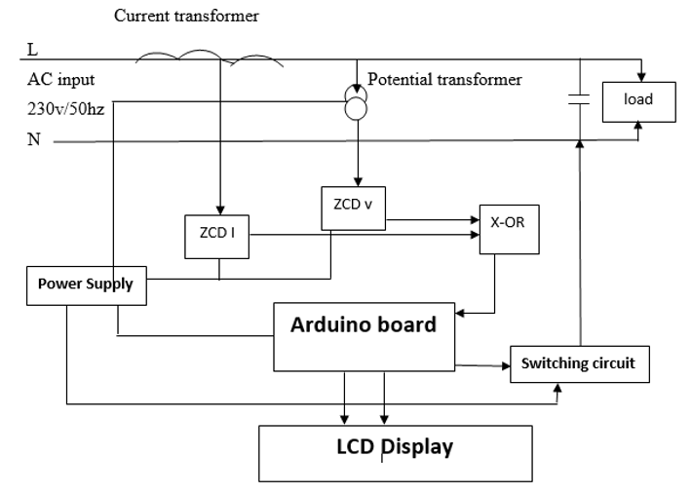
Methodology
I am going to do,
An Automatic power factor correction method – it can be used at household purpose and industry also
Add power controller system to a load – it will help to maintain the system stable
Design the project and implement it as Simulation Method (Unavailability of laboratory type equipment)
Going to have a sample small scale Physical Project using Arduino + components to ensure that the project idea is correct

Slide 5
Time Line Plan
01
02
03
04
05
06
07
08
09
10
11
12
13
14
Project Proposal and Planning
Installation and Gathering
Implementation
Extracting results
Results analysis
Concluding
Deliverable : Final report

Slide 6
Barathraj M. 190091K
Thank you!

